Slide 1
A 29-year-old man with Crohn’s disease who complained of prolonged fever
Luan Minh Dang, MD.

Slide 2
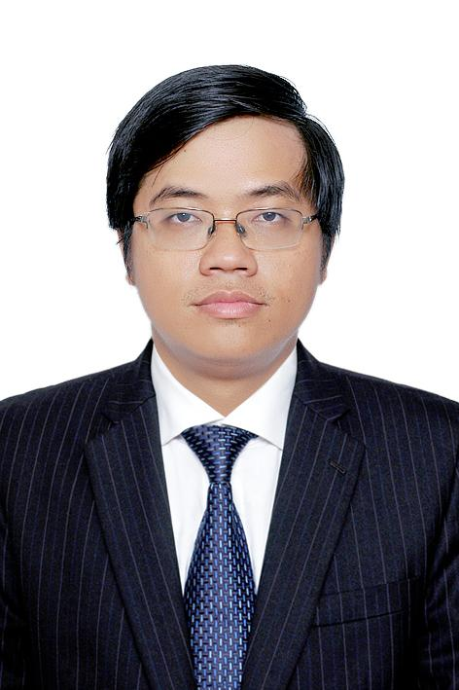
Introduction
Luan Minh Dang, MD.
IBD Unit – Department of Gastroenterology, University Medical Center, Ho Chi Minh City, Viet Nam.

Slide 3
Case presentation
A 29 year-old man.
Chief complaint: fever
Past medical history: Crohn’s disease treated with IFX + AZA

Slide 4
9 months before this admission
Diarrhea, RLQ pain, weight loss and oral ulcer
Fecal calprotectin: > 800µg/g
  Colonoscopy: ileal ulcer
CT Enterography:
  Wall thickening in 4 segments of the ilium + comb sign, compatible with Crohn’s disease. No stricture or fistulae.
Upper endoscopy: esophageal ulcer, antral erosions

Slide 5
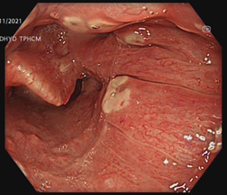
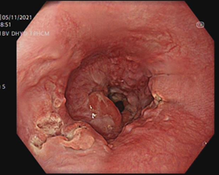
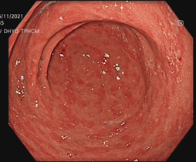
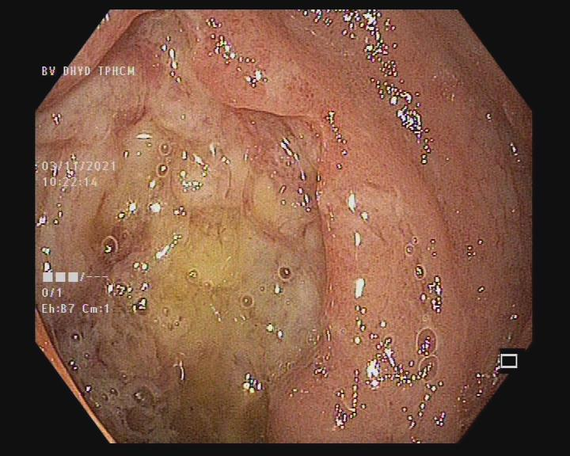
Past medical history

Slide 6
9 months before this admission
  Histology:
    ilium: transmural inflammation compatible with CD
    Oral cavity, esophagus, antrum: compatible with CD
  Treatment:
    Methylprednisolone 32mg/day (tapered down)
    Azathioprin (gradually increase to 2mg/kg)

Slide 7
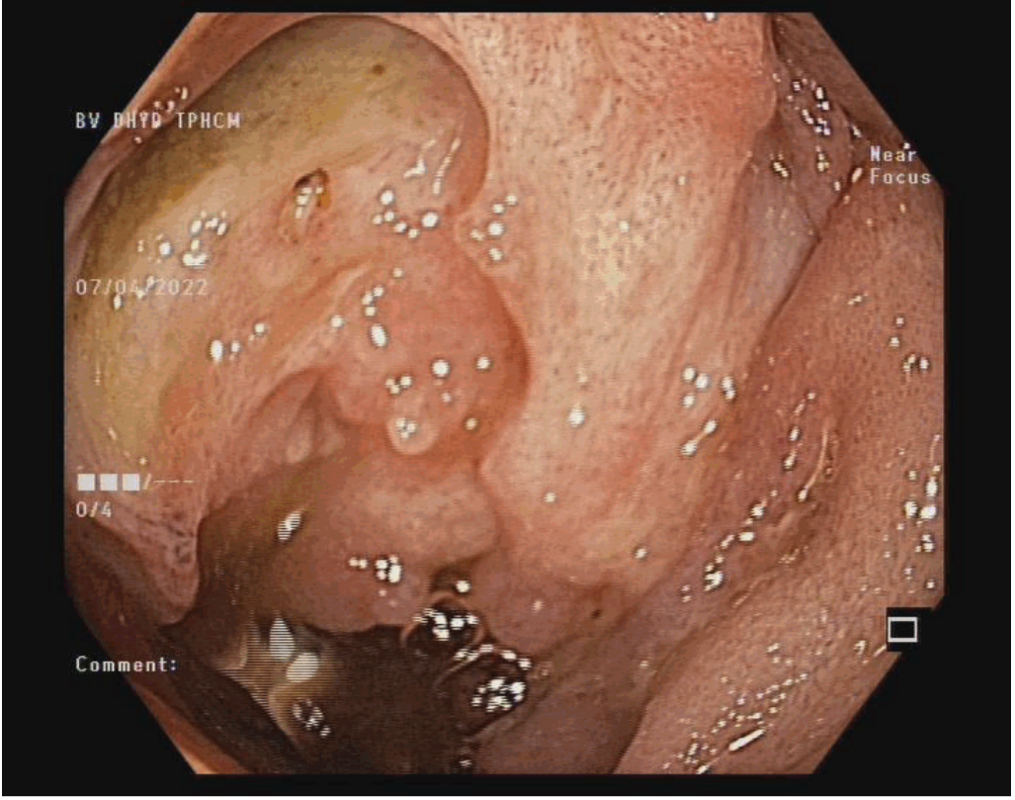
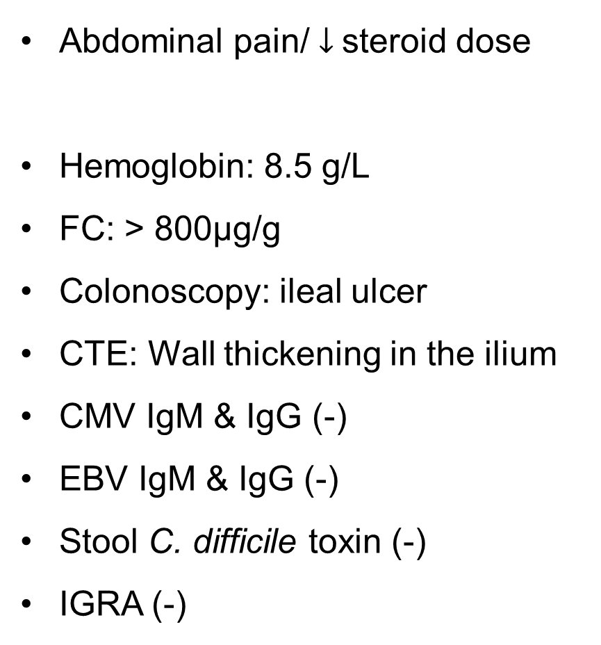
4 months before this admission
Abdominal pain/ $↓$steroid dose
Hemoglobin: 8.5 g/L
FC: > 800µg/g
Colonoscopy: ileal ulcer
CTE: Wall thickening in the ilium
CMV IgM & IgG (-)
EBV IgM & IgG (-)
Stool C. difficile toxin (-)
IGRA (-)
Start IFX 5mg + AZA

Slide 8
2 months before this admission
2 week after 3th dose of IFX
Fever: 38-38.5ºC
Fatigue
WBC: 4,790 per mm³
HGB: 6.3 g/dL
PLT: 315,000 per mm³
AST: 25 U/L
ALT: 21 U/L
PCT: 0.037 ng/mL
Blood culture (-)
Urine culture (-)
Stool C. difficile toxin (+)
Stool exam: no parasite
EBV IgM (-)
CMV IgM (-)
Fibrinogen: 4.31 g/L
Ferritin 108 ng/mL
ANA (-)

Slide 9
2 months before this admission
CTE: active ileal CD. No abscess
Chest CT: normal
Bronchoscopy with bronchoalveolar lavage: no evidence of TB
Colonoscopy and biopsy: No CMV colitis or lymphoma.
Patient refused to preform bone marrow aspirates
Treatment:
  RBC transfusion + iron supplement
  Oral vancomycin 500mg q.d 14 days
  Stop AZA

Slide 10
1 month before this admission
1 month after stopping AZA and oral vancomycin
No fever
WBC: 9,230 per mm³
HGB: 11.1 g/dL
PLT: 315,000 per mm³
Re-start IFX 5mg/kg
  1 week after re-start: low-grade fever

Slide 11
At admission
High-grade fever 39-40ºC
Mild abdominal pain
WBC: 3,290 per mm³
Neutrophil: 3,030 per mm³
HGB: 7.2 g/dL
PLT: 83,000 per mm³
AST: 234 U/L
ALT: 328 U/L
Total Bilirubin: 2.89 mg/dL
PCT: 3.6 ng/mL
Blood culture (-)
Urine culture (-)
Stool C. difficile toxin (-)
Stool exam: no parasite
CTE: active ileal CD. No abscess. No splenomegaly
Chest CT: normal

Slide 12
At admission
Ferritin: 639 ng/mL
Triglyceride: 3.17 mmol/L
Fibrinogen: 1.34 g/L
Bone marrow: hemophagocytosis

Slide 13
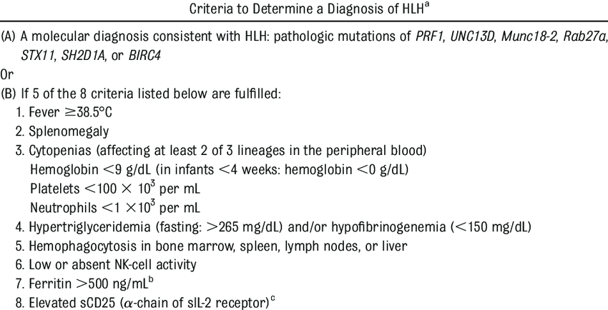
EBV PCR: 2x10³ copies/mL
CMV PCR: (-)

Slide 14
Summary
Problems:
EBV induced hemophagocytic lymphohistiocytosis
Crohn’s disease treated with IFX (+ AZA)
Treatments:
Stop IFX
Meropenem + vancomycin
Dexamethasone
Transfer to hematology department

Slide 15
Summary
No fever
↑ HGB
Re-start IFX
Start IFX + AZA
9M
4M
2M
1M
1W
Dx of CD
Start oral steroid + AZA
3rd dose of IFX
Low-grade fever
Severe anemia
Dx of C. difficle colitis
➔ Oral vancomycin
Stop AZA
Refused bone marrow aspirates
Fever
Admission
DX of HLH

Slide 16
Questions
Did HLH occur 2 months before this admission when patient had prolonged low grade fever attributed to C. difficile colitis?
Was the predisposition to EBV infection in this patient due to infliximab?
Do you check EBV status before starting anti TNF and/or thiopurin in your daily practice?

Slide 17

Thank you for listening!

